Slide 1

Extraversion and
Social Networks
Exploring the Relationship Between Personality and Social Circles
Undergraduate Lecture Series

Slide 2

The Architecture of
Human Connections
Foundations of Personal Network Analysis

Slide 3
What is a Social Network?
Definition: The set of personal ties an individual maintains with others, including family, friends, and acquaintances.
Diversity: Networks vary significantly in size and composition across different people.
Influencers: Factors like age, sex, and socioeconomic status naturally shape who we are connected to.
The Big Question: Does our personality (like being an extravert) determine how many friends we have?

Slide 4
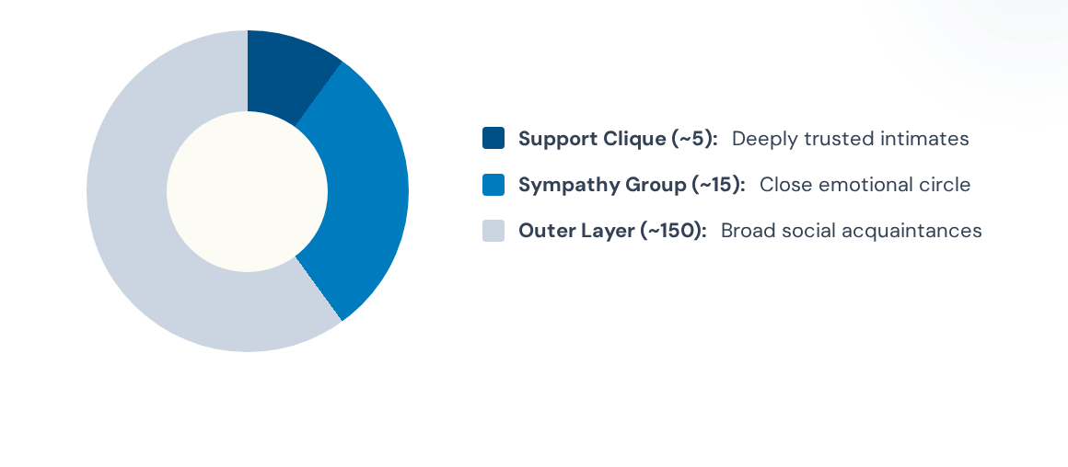
The Layers of Connection
Dunbar’s Number suggests our cognitive capacity limits these layers to predictable sizes.

Slide 5

Extraversion: The Social Engine
Extraverts
Introverts
Outgoing, gregarious, and energetic. They actively seek social attention and enjoy participating in group activities. They often possess superior social skills and higher interaction rates.
Tend to be more reserved and pensive. While they value social connections, they may find large group settings more taxing and maintain smaller, highly focused circles of interaction.

Slide 6
Key Research Findings
Synthesizing Results from Pollet et al. (2011) and Roberts et al. (2008)

Slide 7
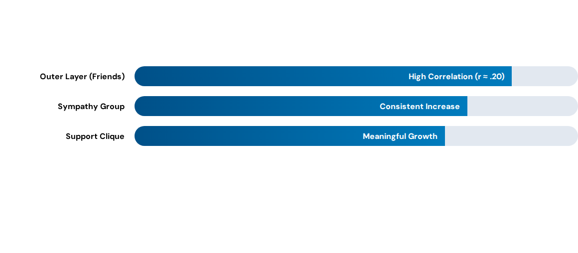
Quantity: Extraverts Have More
Extraverts maintain larger networks at every layer, primarily driven by their friend circles rather than family.

Slide 8
The Emotional Paradox
0
Zero Increase in Emotional Closeness
Despite having larger networks, extraverts do not feel emotionally closer to their contacts. This finding remains true even when controlling for network size. Quantity does not automatically equal quality.

Slide 9
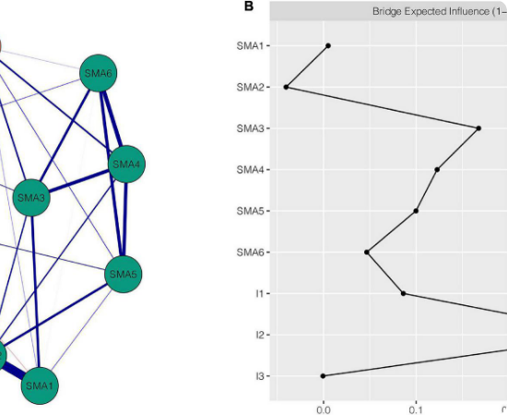
The Impact of Age
As we age, our extraversion levels tend to naturally decline. Research by Roberts et al. (2008) highlights that age is a major "confound."
In diverse populations, the link between extraversion and network size often disappears once age is factored in. Age is the single best predictor of network shifts.

Slide 10






Gender and Neuroticism
Sexual Segregation
Neuroticism
Education
People tend to connect with their own gender. Men have more male friends, and women have more female friends in their core layers.
Interestingly, neuroticism has little to no effect on the size of the network layers, though it may influence how people perceive support.
Higher education (university degree) is sometimes linked to lower reported emotional closeness in the outer social layers.

Slide 11
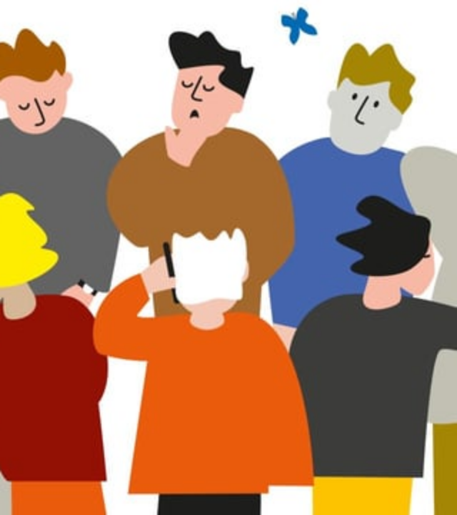
Quantity vs. Quality
The Core Conclusion
Extraversion provides the social skills to reach further, but not necessarily to dig deeper.
While extraverts are better at replacing members and managing large groups, their emotional investment per person remains identical to introverts.
Broad reach, standard depth.

Slide 12
Questions?
Thank you for your participation.
Contact: psychology.lectures@university.edu
Sources: Pollet et al. (2011) | Roberts et al. (2008)

Slide 13


Image Sources
https://www.frontiersin.org/files/Articles/993328/xml-images/fpsyt-13-993328-g001.webp
Source: www.frontiersin.org
https://external-preview.redd.it/should-the-daily-stand-up-die-v0-QkJCZwFqxC9KXd0_6gvX-2a7NHWTjnNkCCgPyhcpKuc.jpg?width=640&crop=smart&auto=webp&s=82491f6086a9734f8a04d51aeefb9b404a238290
Source: www.reddit.com

